Slide 1
Learning Objective
I will be able to establish a rule connect $y$ and $x$
Success Criteria
At the end of the lesson, I will be able to:
understand the concept of direct proportion and be able to determine the constant of proportionality for related variables;
understand the concept of inverse proportion and be able to determine the constant of inversely proportionality for related variables;

Slide 2
Recognising linear functions from a table of values
Activating Prior Knowledge
2
2
2
2
First order difference
Constant – for every 1 unit increase in x, y increases by 2 units
This is the gradient of y = mx + c

Slide 3
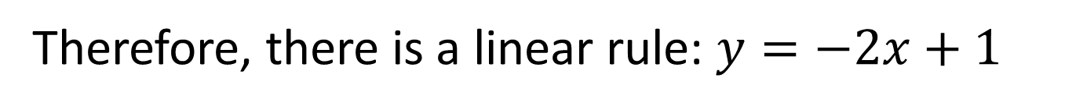
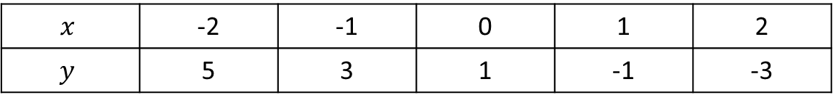
Activating Prior Knowledge
Determine the rule of the table of values
$$x$$ | -2 | -1 | 0 | 1 | 2
$$y$$ | 5 | 3 | 1 | -1 | -3
First order difference is a constant
-2
-2
-2
-2
Therefore, there is a linear rule: $y=−2x+1$

Slide 4
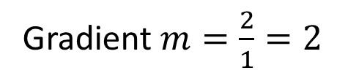
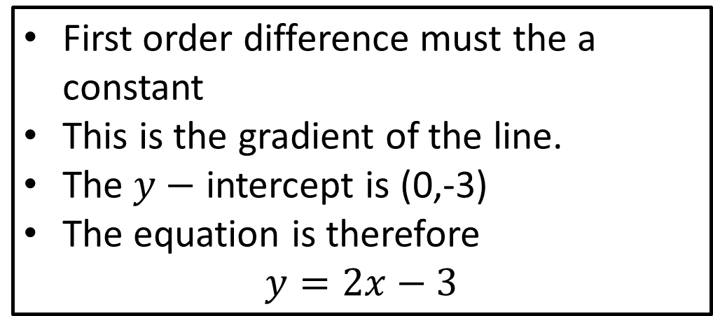
Practice
Determine the rule of the table of values
+1
+1
+1
+1
+1
+1
Gradient $m=\frac{2}{1}=2$
+2
+2
+2
+2
+2
+2
First order difference must the a constant
This is the gradient of the line.
The $y−$ intercept is (0,-3)
The equation is therefore
$$y=2x−3$$

Slide 5
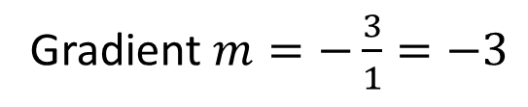
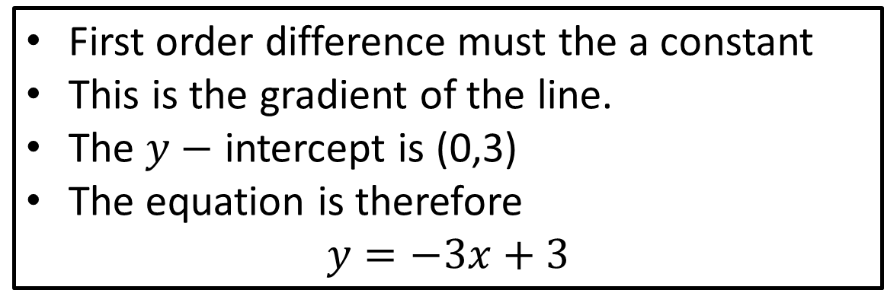
Practice
Determine the rule of the table of values
+1
+1
+1
+1
+1
+1
-3
-3
-3
-3
-3
-3
First order difference must the a constant
This is the gradient of the line.
The $y−$ intercept is (0,3)
The equation is therefore
$$y=−3x+3$$
Gradient $m=−\frac{3}{1}=−3$

Slide 6
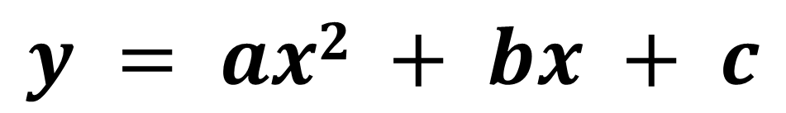
Concept Development
-3
-1
+1
+3
Second order difference is a constant
+2
+2
+2
Therefore, there is a quadratic rule of the form:
$$y = ax2 + bx + c$$

Slide 7

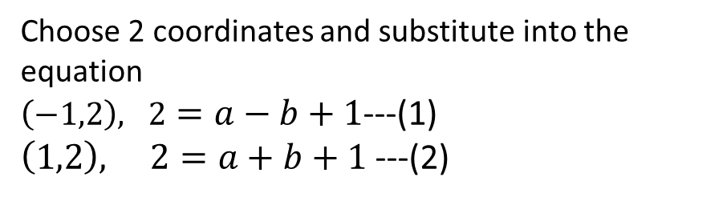
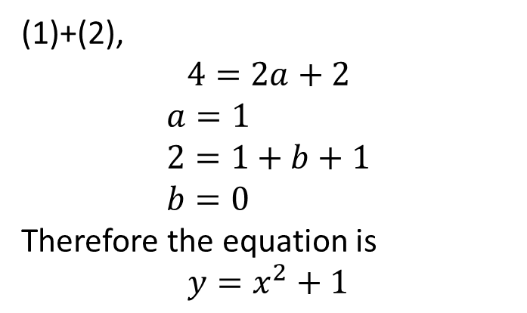
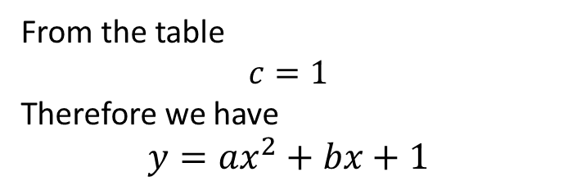
Practice
Determine the rule of the table of values
-3
-1
+1
+3
$$y = ax2 + bx + c$$
+2
+2
+2
From the table
$$c=1$$
Therefore we have
$$y={ax}^{2}+bx+1$$
(1)+(2),
$$4=2a+2$$
$$a=1 \\ 2=1+b+1 \\ b=0$$
Therefore the equation is
$$y=x^{2}+1$$
Choose 2 coordinates and substitute into the equation
$\left(−1,2\right), 2=a−b+1$---(1) $\left(1,2\right), 2=a+b+1$ ---(2)

Slide 8
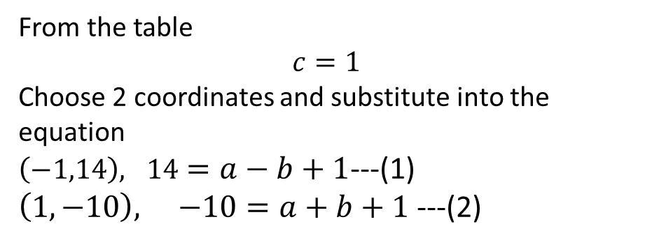

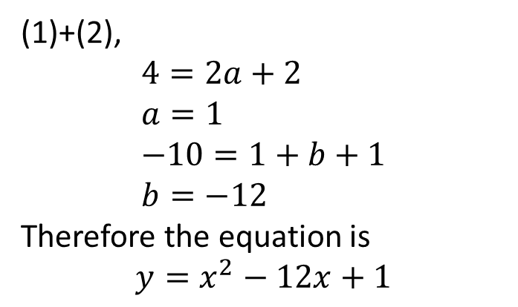
Practice
Determine the rule of the table of values
-15
-13
-11
-9
$$y = ax2 + bx + c$$
+2
+2
+2
(1)+(2),
$$4=2a+2 \\ a=1 \\ −10=1+b+1 \\ b=−12$$
Therefore the equation is
$$y=x^{2}−12x+1$$
From the table
$$c=1$$
Choose 2 coordinates and substitute into the equation
$\left(−1,14\right), 14=a−b+1$---(1) $\left(1,−10\right), −10=a+b+1$ ---(2)

Slide 9
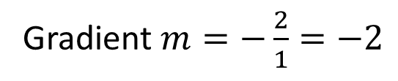
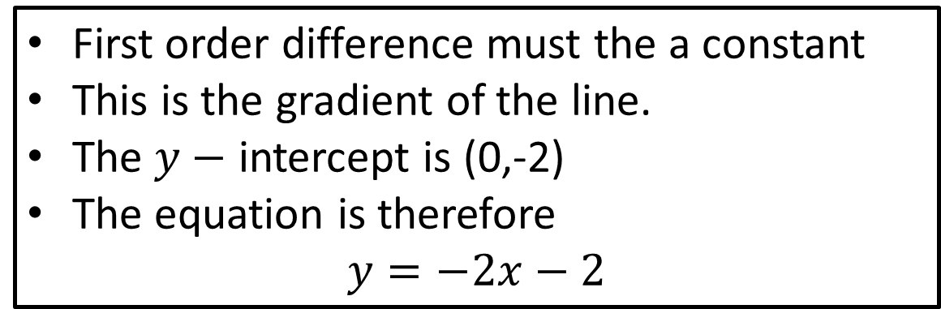
Practice
Determine the rule of the table of values
+1
+1
+1
-2
-2
-2
First order difference must the a constant
This is the gradient of the line.
The $y−$ intercept is (0,-2)
The equation is therefore
$$y=−2x−2$$
Gradient $m=−\frac{2}{1}=−2$

Slide 10
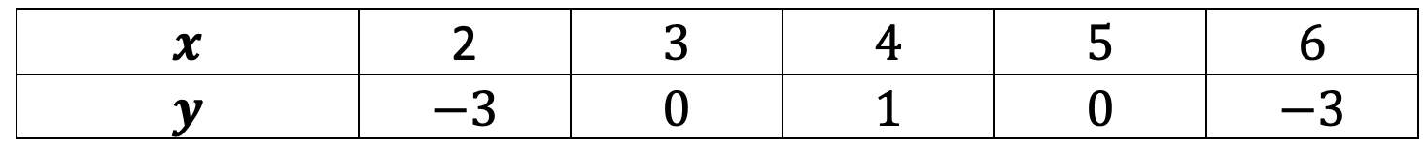
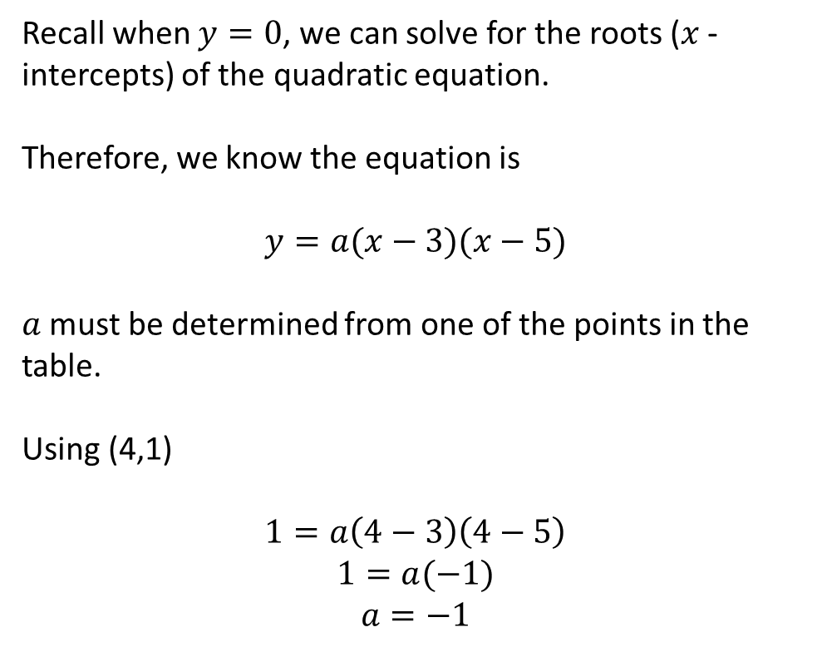
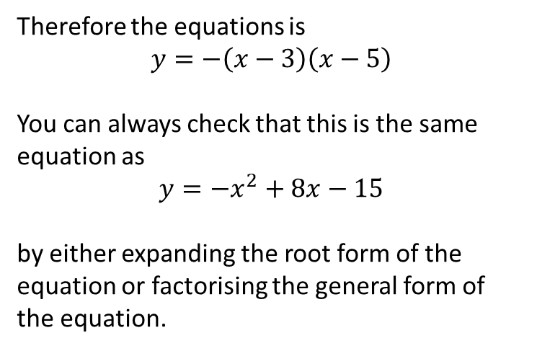
Practice
Determine the rule of the table of values
Recall when $y=0$, we can solve for the roots ($x$ - intercepts) of the quadratic equation.
Therefore, we know the equation is
$$y=a(x−3)(x−5)$$
$a$ must be determined from one of the points in the table.
Using (4,1)
$$1=a\left(4−3\right)\left(4−5\right)$$
$$1=a(−1)$$
$$a=−1$$
Therefore the equations is
$$y=−\left(x−3\right)\left(x−5\right)$$
You can always check that this is the same equation as
$$y={−x}^{2}+8x−15$$
by either expanding the root form of the equation or factorising the general form of the equation.

Slide 11
Independent Practice
Complete Ex 5 Fitting Data Worksheet

